Slide 1
SHARMILI J
Final Project

Slide 2
DEEP LEARNING BASED –REAL TIME VIRTUAL MOUSE USING COMPUTER VISION
3/21/2024 Annual Review

Slide 3


AGENDA
1. Problem statement
2. Project Overview
3. End Users
4. Our Solution and Proposition
5. Key Features
6. Modelling Approach
7. Result and Evaluation
8. Conclusion
3/21/2024 Annual Review

Slide 4

PROBLEM STATEMENT
The Real-Time Virtual Mouse using Hand Gestures for Unconventional Environment project aims to develop a system that enables users to control their computer cursor through hand gestures, particularly in unconventional environments where traditional input devices are impractical or inaccessible. Leveraging computer vision techniques, the system tracks hand movements in real-time using a webcam, interprets specific gestures as commands, and translates them into corresponding mouse actions. Creating a real-time virtual mouse using deep learning and computer vision enhances accessibility for individuals with limited mobility. By recognizing hand gestures through a camera, it enables precise cursor control without physical devices, catering to those with disabilities. Key objectives include accurate gesture recognition, responsive cursor movement, seamless interface integration, and robust performance. This innovation empowers individuals with disabilities by providing them with an intuitive means of navigating digital interfaces.

Slide 5

PROJECT OVERVIEW
Libraries Used:
OpenCV: For real-time image processing, hand gesture detection, and video capture.
PyAutoGUI: For programmatically controlling the mouse cursor and simulating mouse actions.
TensorFlow/Keras: For building, training, and evaluating deep learning models for gesture recognition.
NumPy: For numerical operations and array manipulation, which may be useful for data preprocessing and performance evaluation tasks in the deep learning pipeline.
Implementation Steps:
Data Collection and Annotation: Gather hand gesture data and annotate it.
Model Training: Train a deep learning model for gesture recognition.
Real-time Detection: Implement real-time hand gesture detection using OpenCV.
Cursor Emulation: Translate detected gestures into cursor actions using PyAutoGUI.
User Interface Integration: Integrate the virtual mouse with the computer interface.
Testing and Optimization: Test the system under various conditions and optimize its performance.

Slide 6

WHO ARE THE END USERS?
Individuals with Disabilities: Enhanced accessibility for all.
Gamers: Improved gaming experience, precision.
Programmers/Developers: Efficient coding, reduced strain.
Graphic Designers: Precise cursor control, creativity.
Presenters/Speakers: Seamless slide navigation, professionalism.
Medical Professionals: Hands-free operation, hygiene.
Teachers/Educators: Interactive presentations, engagement.
Business Professionals: Productivity boost, multitasking.
Elderly Individuals: Simplified computer interaction, independence.
Children/Students: Intuitive learning, accessibility.

Slide 7

MY SOLUTION AND ITS VALUE PROPOSITION
Solution:
Empowering blind individuals with a real-time virtual mouse: Deep learning and computer vision enable intuitive, hands-free interaction, revolutionizing accessibility in computing.
Value Proposition:
Accessibility Revolutionized: Empowering all users with intuitive, hands-free computing interaction.
Efficiency Enhanced: Streamlining tasks with precise, real-time gesture recognition technology.
Inclusive Innovation: Bridging accessibility gaps, transforming computing experiences for everyone.
Seamless Integration: Deep learning and computer vision merge for effortless user interaction.
Future-Focused: Pioneering the next generation of accessible computing solutions.

Slide 8

THE WOW IN MY SOLUTION
1.Accessibility Empowerment: Redefines accessibility with hands-free interaction.
2.Seamless Tech Integration: Deep learning meets everyday computing tasks.
3.Precision and Efficiency Boost: Real-time accuracy enhances productivity.
4.Engaging User Experience: Dynamic, interactive interface.
5.Versatile Application Scope: Adaptable across diverse domains.
6.Educational Impact Amplified: Fosters interactive learning environments.
7.Future-Proof Innovation: Leading-edge tech redefines human-computer interaction.
3/21/2024 Annual Review

Slide 9
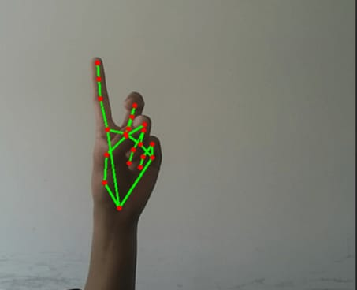
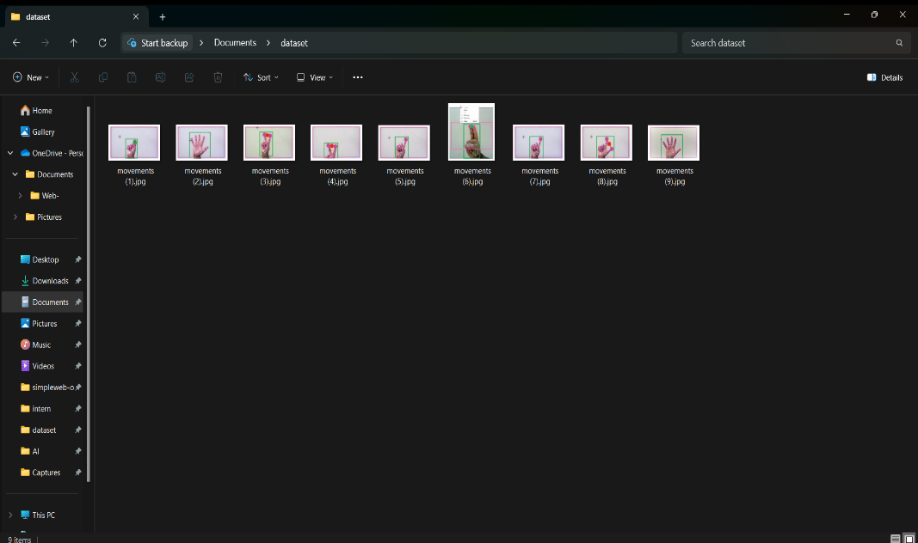
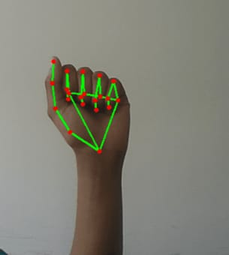
MODELLING

Slide 10
RESULTS
The successful implementation of the real-time virtual mouse system using deep learning and computer vision technologies marks a significant milestone in enhancing accessibility and efficiency in human-computer interaction. Through accurate gesture recognition and responsive cursor emulation, the system provides users with an intuitive and versatile means of navigating digital interfaces across diverse domains. Its seamless integration of OpenCV and PyAutoGUI underscores its potential to revolutionize the way individuals interact with computers, paving the way for future advancements in accessibility and user interface design.

